Slide 1
Cancer

Slide 2
Agenda
Types of Cancer
Screening & Assessments
Treatments & Side Effects
Patient Experience

Slide 3
Important Terminology
Neoplasm – (aka: a tumor) a mass that develops when tissue cells begin to divide and multiply uncontrollably
Neoplasms can be benign (slow and localized growths) or malignant (growths that develop quickly and can metastasize)
Metastatic – the capability to spread from one location to another
Five-year survival rate – the estimated proportion of patients expected to be alive five years after diagnosis
Biopsy – a procedure to remove a small sample of cells or tissue to test for diseases, infection, or cancer
Adjuvant therapy – when more than one therapy is used to treat a disease, typically administered after the primary treatment
Neoadjuvant therapy – when more than one therapy is used to treat a disease, where the additional treatment is given before the primary treatment

Slide 4
Types of Cancer
There are over 200 types of cancer, but most can be classified based on their primary site (e.g., breast or lung) or by their histological type.
A histological type refers to the type of tissue where cancer originates, and includes:
Carcinoma – cancer that forms from epithelial tissues (which form the internal and external lining of the body)
Carcinomas make up 80-90% of all cancers; ex: breast, lung, pancreatic, and colon cancer
Sarcoma – cancer that forms in connective tissue (such as bones, tendons, cartilage, muscles, and fat)
Leukemia – cancer that originates in the bone marrow; “liquid” blood cancer
Lymphoma – cancer of the lymphatic system, through lymphocytes; “solid” blood cancer
Myeloma – cancer that originates in the plasma cells of bone marrow, impacting lymphatic system
Brain & spinal cord cancers – cancer that start in the cells of the brain or spinal cord
As a note, some cancers could be considered a combination of these categories (ex: endometrial carcinosarcoma)

Slide 5
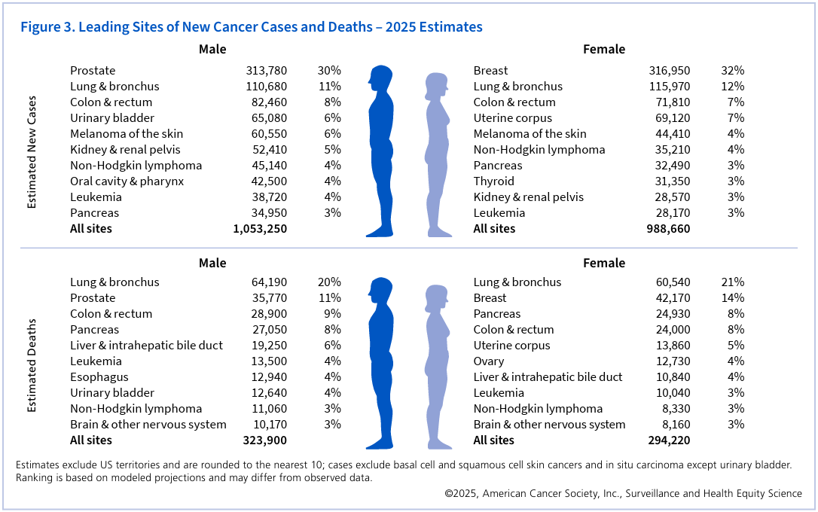
Most Common Types of Cancer

Slide 6
Why Do Most Types of Cancer Develop?
Genetics
Epigenetics – the process by which environmental factors (stress, health behaviors, etc.) have the ability to turn genes “on” or “off,” often through methylation/ demethylation
Germs from certain infections can force epigenetic changes
Individuals who smoke often have less DNA methylation than nonsmokers
Health behaviors (diet, substance use, exercise, etc.)
Chemical and radiation exposure
Age

Slide 7
Cancer Screening
It is recommended people regularly scan for the following types of cancer, especially after reaching 40 years old.
Breast Cancer
Mammograms, or potentially an ultrasound or MRI
Colon Cancer
Colonoscopy or stool-based test
Cervical Cancer
Pap smear and HPV test
Prostate Cancer
Digital rectal exam and prostate-specific antigen blood test
Lung Cancer (if patient has smoking history)
CT scan

Slide 8
Cancer Staging
If cancer is detected, there are a variety of ways it can be staged, depending on cancer type.
The most common type is the TNM Staging System
T – tumor size/ extent
TX (can’t be measured), T0 (can’t be found), T1, T2, T3, T4 (higher = larger)
N – nearby lymph nodes that have cancer
NX (can’t be measured), N0 (no nearby cancer), N1, N2, N3 (higher = more)
M – metastasis
MX (can’t be measured), M0 (has not spread), M1 (has spread)
These can be condensed into broader categories of Stage 1 (small, localized), Stage 2 (larger, potential spread to lymph nodes), Stage 3 (larger and deeper, likely involves lymph nodes), and Stage 4 (metastasized)

Slide 9
Cancer Staging
Other forms of cancer have staging systems specific to that type of cancer
For example, lymphomas use the Lugano classification system
Number System
Stage 1 – Single/ adjacent lymph nodes
Stage 2 – Multiple lymph nodes
Stage 3 – Lymph nodes above and below diaphragm OR lymph nodes + spleen
Stage 4 – Wide spread, including organ or bone marrow involvement
Can include alphabetic identification for symptoms
A – largely asymptomatic
B – experiencing multiple negative symptoms (weight loss, night sweats, etc.)
X – bulky disease (mass is multiple centimeters in diameter)

Slide 10
Why might the TNM system not be a good choice for staging blood cancers?

Slide 11
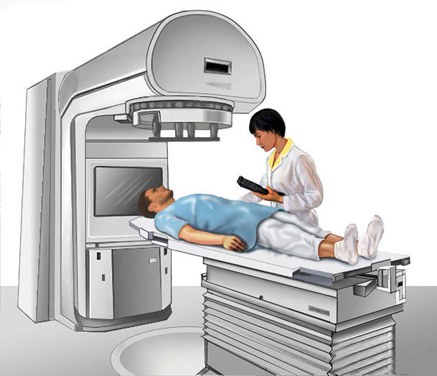
Cancer Treatments
Surgery
Chemotherapy
Can be oral, intravenous, intramuscular, subcutaneous
Widespread treatment to shrink/ kill cells
Radiation therapy
Localized treatment to shrink/ kill cells with powerful rays
Immunotherapy
Boost the body’s ability to fight the cancer
Hormone therapy
Blood or bone marrow transplant

Slide 12
Common Side Effects
While symptoms can be different between treatments, common side effects include:
Organ damage (especially heart, lungs, kidneys, and liver)
Loss of or damage to areas that reproduce quickly, including hair, skin, nails, and reproductive organs
Can lead to additional symptoms, such as mouth and throat sores
Nausea/ vomiting, and other digestive issues
Fatigue
Immunocompromised
Cognitive impairment
Neuropathy
Infertility/ fertility issues
Stress, depression, and anxiety

Slide 13
The (Most Common) Cancer Treatment Process
Step 1 – Screening
Step 2 – Further diagnostics (typically, biopsies)
Step 3 – Health and severity assessment (ex: pulmonary function test, echocardiograms, blood tests, ultrasounds, etc.)
Positron emission tomography (PET) scan – a form of CT scan that combines radioactive material with a sugar molecule, then scans the body to see which areas show the sugar being “eaten”
Step 4 – Preparation (ex: surgery for a PIC line or porta catheter for chemo)
Step 5 – Treatment(s)
Step 6 – Scanning (periodical and at end of treatment)
Step 7 – Follow-up scans

Slide 14
What are factors that could improve or hinder patient experience?

Slide 15
Common Examples of The Patient Experience
Sense of relief when diagnosed
Shame/ embarrassment
Challenges to self-efficacy
Struggles with conflicting advice/ opinions
Struggle more with the side effects than the disease
Difficulty in finding their “cancer center home” (quality of service versus resources available)

Slide 16
Next Time on PSY 440…
Before Next Class:
Complete today’s journal prompt
Due Wednesday at 11:59 pm
Work on HIP
In Our Next Class:
Class Activity

